Slide 1


Richard J. Ollio
4/21/2022

Slide 2

Outline
Executive Summary
Introduction
Methodology
Results
Conclusion
Appendix

Slide 3
Executive Summary
Summary of methodologies
The project focused on three main methodologies in order to complete the scope of the project. They are: wrangling and cleaning the data (Exploratory Data Analysis), visualizing the data effectively, and using predictive analytics to attempt to predict if a launch was going to fail, and to try and figure out the main factors that are contributing to the success or failure of a given mission.
Summary of all results
By completing the above methodologies we found that there was a definitive correlation between some of the factors and predicting mission failure/success. This is shown by visualizing the data effectively and respective predictive analytics in trying to predict mission failure.

Slide 4
Introduction
Project background and context
The project is looking at SpaceX Reusable rocket launches and trying to determine why a mission is met with success or failure. Falcon 9 rocket launches cost approximately $62 million, so success or failure is a very costly factor. SpaceY wants to use this data to effectively compete with SpaceX and break into the commercial rocket launching business. We will do this by reworking and exploring the SpaceX data, visualizing it effectively, and then to use the Space X data to predict what makes a rocket mission successful or a failure, so we can better engineer our rockets to have the most success possible.
Problems you want to find answers
What causes a rocket launch to land successfully or not?
What are the biggest factors when launching and landing so we can reuse the first stage?
What is the price of each launch by each launch type?

Slide 5

Section 1

Slide 6
Methodology
Executive Summary
Data collection methodology:
Data was collection by webscaping spacexdata.com using an API call.
Perform data wrangling
Data was standardized by dealing with missing values in the data set and by making sure that values were in the correct data type.
Perform exploratory data analysis (EDA) using visualization and SQL
Perform interactive visual analytics using Folium and Plotly Dash
Perform predictive analysis using classification models
By using different methods of classification and by measuring their individual effectivness we can find the best classification model to use for our data model.

Slide 7
Data Collection
Data sets were collected from the spacexdata.com site using an API call to the site to web scrape the site and load in the data. This was split into grabbing the rockets, launchpads, payloads, and cores.
You need to present your data collection process use key phrases and flowcharts
SpaceX Rockets
SpaceX Launchpads
SpaceX Payloads
SpaceX Cores
API
API
API
API
Compile & Load
Model Raw Data
Filter, Wrangle, and Clean Data
Model Data

Slide 8
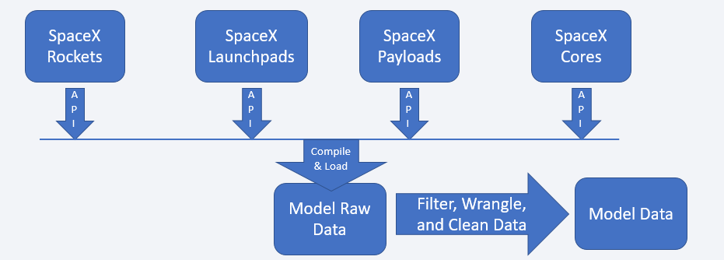
Data Collection – SpaceX API
Present your data collection with SpaceX REST calls using key phrases and flowcharts
Add the GitHub URL of the completed SpaceX API calls notebook (must include completed code cell and outcome cell), as an external reference and peer-review purpose

Slide 9
Data Collection - Scraping
Present your web scraping process using key phrases and flowcharts
Add the GitHub URL of the completed web scraping notebook, as an external reference and peer-review purpose

Slide 10
Data Wrangling
Data collection methodology:
Data was collection by webscaping spacexdata.com using an API call.
Perform data wrangling
Data was standardized by dealing with missing values in the data set and by making sure that values were in the correct data type.
Perform exploratory data analysis (EDA) using visualization and SQL
Perform interactive visual analytics using Folium and Plotly Dash
Perform predictive analysis using classification models
By using different methods of classification and by measuring their individual effectivness we can find the best classification model to use for our data model.

Slide 11
EDA with Data Visualization
Summarize what charts were plotted and why you used those charts
Flightnumber by Payload Mass Scatterplot – To show that across flight numbers/time how the payload mass changed over time and how that affected the failure or success numbers – mass increases over time and failure rate decreases over time.
Flightnumber by Launch Site Scatterplot – To show how flight number and the site affected the success/failure – VAFB SLC stopped being used and KSC LC 38A was started after the others. The large % of failures occurred on the CCAPS SLC 40 site.
Payload vs Launch Site Scatter – Payloads under 6000 kg held most of the failures.
Ploted bar chart of Orbit and Outcome% - GTO, ISS are worst performers at <60%.
Add the GitHub URL of your completed EDA with data visualization notebook, as an external reference and peer-review purpose

Slide 12
EDA with SQL
Using bullet point format, summarize the SQL queries you performed
Displayed Unique Launch Sites
Displayed a limited set of records (5) where the launch site begins with ‘CCA’
Displayed the total payload mass of NASA launched boosters
Displayed average payload mass carried by booster F9 v1.1
Display the date of the first successful ground pad landing
Display names of boosters with success in drone ship and payload mass between 4000 and 6000 kg
List total number of successful and failure mission outcomes
List booster versions which carried the max payload mass
List failed landing outcomes in drone ship, booster versions, and launch sites for year 2015
Rank count of landing outcomes between June 4, 2010 and March 20, 2017 desc.
Add the GitHub URL of your completed EDA with SQL notebook, as an external reference and peer-review purpose

Slide 13
Build an Interactive Map with Folium
Summarize what map objects such as markers, circles, lines, etc. you created and added to a folium map and explain why
Added markers and circles to show different launch sites on the map and eventually grouping them together as clusters with number and color showing how many launches were from each launch site and the average success of the launch site by color (green, yellow, red to show good to bad results on average) This was started by giving green and red distinctions to single launches to show pass/fail. Also lines were added to show distance between the launch site and certain objects such as railroads, ocean, highway, city-center, etc.
Add the GitHub URL of your completed interactive map with Folium map, as an external reference and peer-review purpose

Slide 14
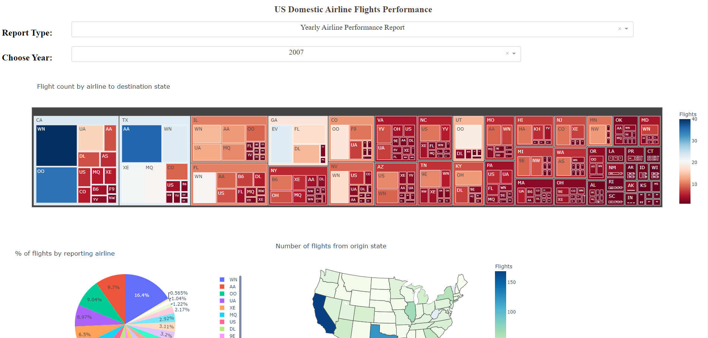
Build a Dashboard with Plotly Dash
I created the US Domestic Airline Flights Performance Dashboard where you can filter by report (dashboard) and the year. Some of the visualizations created were average carrier delay time by airline (line), average weather delay time, Average NAS delay time, flight count by airline to dest. State (heatmap box), % of flights by reporting airline (pie), and number of flights from origin state (geo map)
These were created to give a holistic overview of the airline data we had available over each different year.

Slide 15
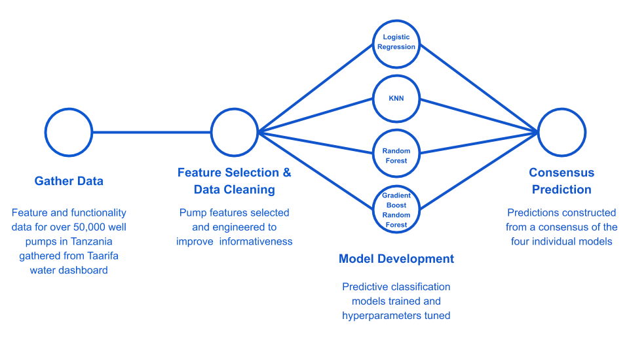
Predictive Analysis (Classification)
We tested each different type of classification model and then calculated the accuracy of each model and what the R-squared value was for each value, the best classification model and the one that was chosen was the one with the lowest R-squared and highest accuracy.

Slide 16
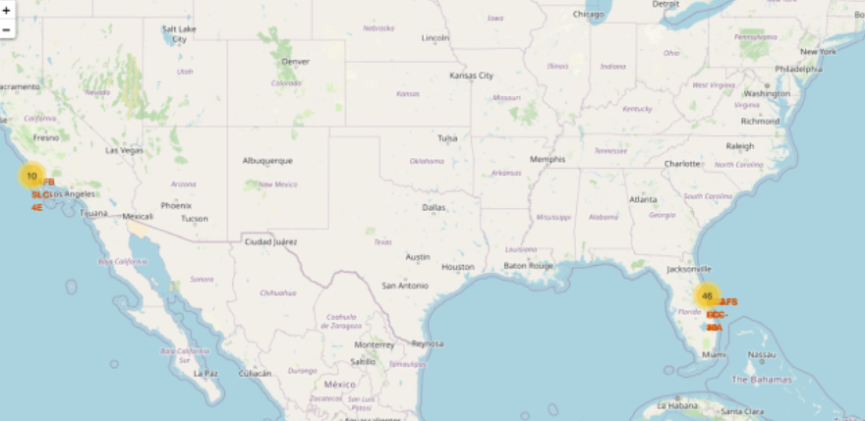
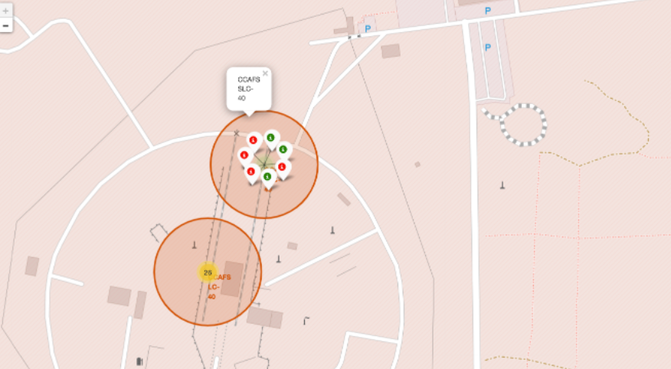
Results
Through exploratory analysis we found what are the most likely factors that cause the failure or success of a rocket phase one landing. This also helped with understanding the data as well as quantifying and qualitatively understanding it. Also, it gave an understanding of what the makeup of the data was, data types, etc. so we would know how to proceed with the data for analysis.
We saw the outcome of the predictive analysis to be that the best model was the decision tree at 83.33%.

Slide 17

Section 2

Slide 18
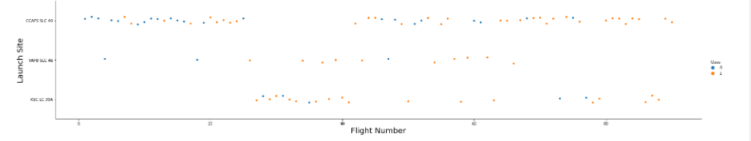
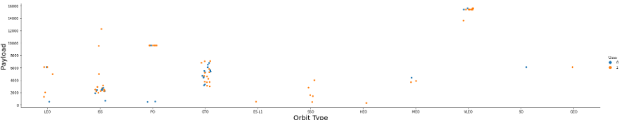
Flight Number vs. Launch Site
Show a scatter plot of Flight Number vs. Launch Site
Show the screenshot of the scatter plot with explanations

Slide 19
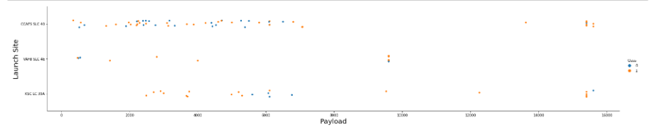
Payload vs. Launch Site
Show a scatter plot of Payload vs. Launch Site
Show the screenshot of the scatter plot with explanations

Slide 20
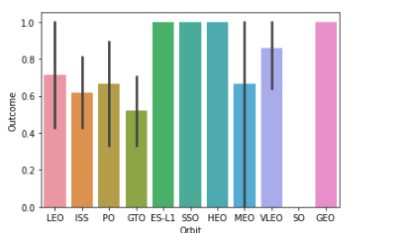
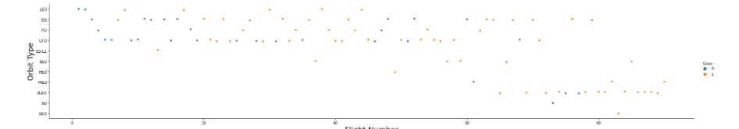
Success Rate vs. Orbit Type
Show a bar chart for the success rate of each orbit type
Show the screenshot of the scatter plot with explanations

Slide 21
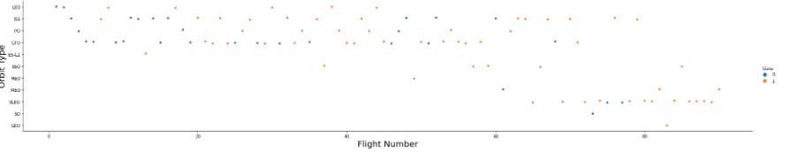
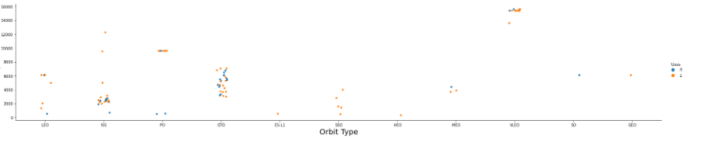
Flight Number vs. Orbit Type
Show a scatter point of Flight number vs. Orbit type
Show the screenshot of the scatter plot with explanations

Slide 22
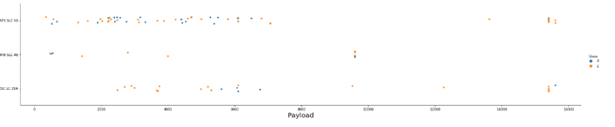
Payload vs. Orbit Type
Show a scatter point of payload vs. orbit type
Show the screenshot of the scatter plot with explanations

Slide 23

Launch Success Yearly Trend
From 2010 to 2013 there was no increase/movement in success. Starting in 2013 launch success increased until 2017, when it took a small tumble back down to around 50% on its way up to 2020 where the success rate is 80%.

Slide 24

All Launch Site Names
Find the names of the unique launch sites
Present your query result with a short explanation here

Slide 25

Launch Site Names Begin with 'CCA'
Find 5 records where launch sites begin with `CCA`
Present your query result with a short explanation here

Slide 26

Total Payload Mass
Calculate the total payload carried by boosters from NASA
Present your query result with a short explanation here

Slide 27

Average Payload Mass by F9 v1.1
Calculate the average payload mass carried by booster version F9 v1.1
Present your query result with a short explanation here

Slide 28

First Successful Ground Landing Date
Find the dates of the first successful landing outcome on ground pad
Present your query result with a short explanation here

Slide 29

Successful Drone Ship Landing with Payload between 4000 and 6000

Slide 30

Total Number of Successful and Failure Mission Outcomes
Calculate the total number of successful and failure mission outcomes
Present your query result with a short explanation here

Slide 31

Boosters Carried Maximum Payload
We used the maximum function (MAX()) to tell what the maximum payload was.

Slide 32

2015 Launch Records
We used a combinations of the WHERE clause, LIKE, AND, and BETWEEN conditions to filter for failed landing outcomes in drone ship, their booster versions, and launch site names for year 2015

Slide 33

Rank Landing Outcomes Between 2010-06-04 and 2017-03-20
We selected Landing outcomes and the COUNT of landing outcomes from the data and used the WHERE clause to filter for landing outcomes BETWEEN 2010-06-04 to 2010-03-20.
We applied the GROUP BY clause to group the landing outcomes and the ORDER BY clause to order the grouped landing outcome in descending order.

Slide 34

Section 3

Slide 35

<Folium Map Screenshot 1>

Slide 36

<Folium Map Screenshot 2>

Slide 37

<Folium Map Screenshot 3>

Slide 38

Section 4

Slide 39

<Dashboard Screenshot 1>

Slide 40

<Dashboard Screenshot 2>

Slide 41

<Dashboard Screenshot 3>
Replace <Dashboard screenshot 3> title with an appropriate title
Show screenshots of Payload vs. Launch Outcome scatter plot for all sites, with different payload selected in the range slider
Explain the important elements and findings on the screenshot, such as which payload range or booster version have the largest success rate, etc.

Slide 42

Section 5

Slide 43

Classification Accuracy
The decision tree classifier is the model with the highest classification accuracy

Slide 44

Confusion Matrix
Show the confusion matrix of the best performing model with an explanation

Slide 45
Conclusions
Point 1
Point 2
Point 3
Point 4
…

Slide 46
# Import required libraries
import pandas as pd
import dash
from dash import html
from dash import dcc
from dash.dependencies import Input, Output, State
import plotly.graph_objects as go
import plotly.express as px
from dash import no_update
# Create a dash application
app = dash.Dash(__name__)
# REVIEW1: Clear the layout and do not display exception till callback gets executed
app.config.suppress_callback_exceptions = True
# Read the airline data into pandas dataframe
airline_data = pd.read_csv('https://cf-courses-data.s3.us.cloud-object-storage.appdomain.cloud/IBMDeveloperSkillsNetwork-DV0101EN-SkillsNetwork/Data%20Files/airline_data.csv',
encoding = "ISO-8859-1",
dtype={'Div1Airport': str, 'Div1TailNum': str,
'Div2Airport': str, 'Div2TailNum': str})
# List of years
year_list = [i for i in range(2005, 2021, 1)]
"""Compute graph data for creating yearly airline performance report
Function that takes airline data as input and create 5 dataframes based on the grouping condition to be used for plottling charts and grphs.
Argument:
df: Filtered dataframe
Returns:
Dataframes to create graph.
"""
def compute_data_choice_1(df):
# Cancellation Category Count
bar_data = df.groupby(['Month','CancellationCode'])['Flights'].sum().reset_index()
# Average flight time by reporting airline
line_data = df.groupby(['Month','Reporting_Airline'])['AirTime'].mean().reset_index()
# Diverted Airport Landings
div_data = df[df['DivAirportLandings'] != 0.0]
# Source state count
map_data = df.groupby(['OriginState'])['Flights'].sum().reset_index()
# Destination state count
tree_data = df.groupby(['DestState', 'Reporting_Airline'])['Flights'].sum().reset_index()
return bar_data, line_data, div_data, map_data, tree_data
"""Compute graph data for creating yearly airline delay report
This function takes in airline data and selected year as an input and performs computation for creating charts and plots.
Arguments:
df: Input airline data.
Returns:
Computed average dataframes for carrier delay, weather delay, NAS delay, security delay, and late aircraft delay.
"""
def compute_data_choice_2(df):
# Compute delay averages
avg_car = df.groupby(['Month','Reporting_Airline'])['CarrierDelay'].mean().reset_index()
avg_weather = df.groupby(['Month','Reporting_Airline'])['WeatherDelay'].mean().reset_index()
avg_NAS = df.groupby(['Month','Reporting_Airline'])['NASDelay'].mean().reset_index()
avg_sec = df.groupby(['Month','Reporting_Airline'])['SecurityDelay'].mean().reset_index()
avg_late = df.groupby(['Month','Reporting_Airline'])['LateAircraftDelay'].mean().reset_index()
return avg_car, avg_weather, avg_NAS, avg_sec, avg_late
# Application layout
app.layout = html.Div(children=[
# TASK1: Add title to the dashboard
# Enter your code below. Make sure you have correct formatting.
html.H1('US Domestic Airline Flights Performance',
style={'textAlign': 'center', 'color': '#503D36', 'font-size': 24}),
# REVIEW2: Dropdown creation
# Create an outer division
html.Div([
# Add an division
html.Div([
# Create an division for adding dropdown helper text for report type
html.Div(
[
html.H2('Report Type:', style={'margin-right': '2em'}),
]
),
# TASK2: Add a dropdown
# Enter your code below. Make sure you have correct formatting.
dcc.Dropdown(id='input-type',
options=[
{'label': 'Yearly Airline Performance Report', 'value': 'OPT1'},
{'label': 'Yearly Airline Delay Report', 'value': 'OPT2'}
],
placeholder='Select a report type',
style={'minWidth': '80%', 'padding': '3px', 'font-size': 20, 'textAlign': 'center'})
# Place them next to each other using the division style
], style={'display':'flex'}),
# Add next division
html.Div([
# Create an division for adding dropdown helper text for choosing year
html.Div(
[
html.H2('Choose Year:', style={'margin-right': '2em'})
]
),
dcc.Dropdown(id='input-year',
# Update dropdown values using list comphrehension
options=[{'label': i, 'value': i} for i in year_list],
placeholder="Select a year",
style={'width':'80%', 'padding':'3px', 'font-size': '20px', 'text-align-last' : 'center'}),
# Place them next to each other using the division style
], style={'display': 'flex'}),
]),
# Add Computed graphs
# REVIEW3: Observe how we add an empty division and providing an id that will be updated during callback
html.Div([ ], id='plot1'),
html.Div([
html.Div([ ], id='plot2'),
html.Div([ ], id='plot3')
], style={'display': 'flex'}),
# TASK3: Add a division with two empty divisions inside. See above disvision for example.
# Enter your code below. Make sure you have correct formatting.
html.Div([
html.Div([ ], id='plot4'),
html.Div([ ], id='plot5')
], style={'display': 'flex'}),
])
# Callback function definition
Appendix
Include any relevant assets like Python code snippets, SQL queries, charts, Notebook outputs, or data sets that you may have created during this project

Slide 47


